Slide 1

Presentation title slide
Analysing Demand Responsive Online Intelligent Transport
Choice Experiment Strategy
Brownbag Seminar
April 12, 2024

Slide 2
Presentation title slide
Flow of the presentation
Introduction to Demand Responsive Transport
Broad scope of the project
Design of stated choice experiments
Points of contention

Slide 3
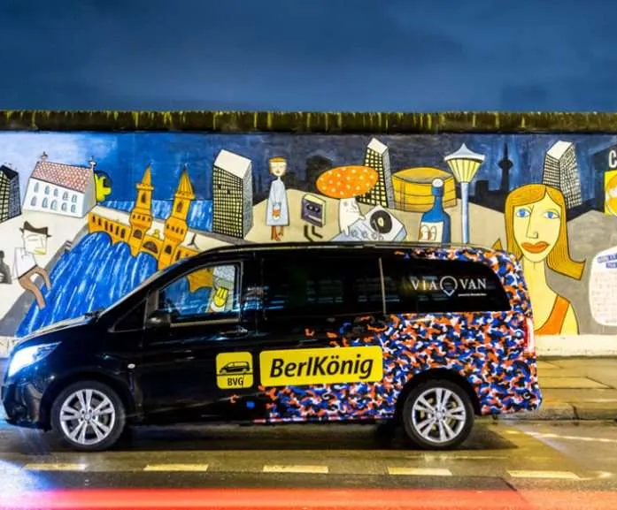
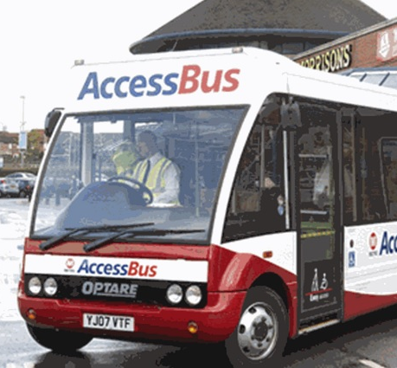
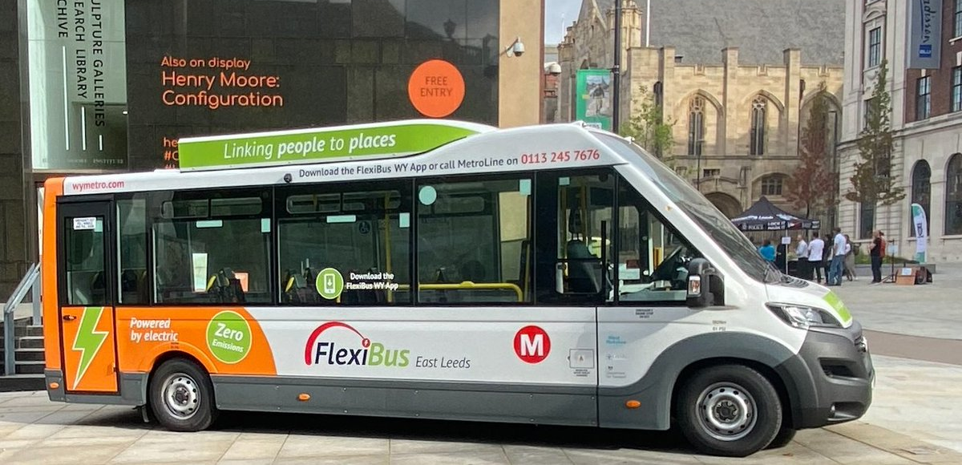
How to display schools and/or Faculties in your slides
Introduction
Demand Responsive Transport
A flexible service that provides shared transport to users that are going in the same general direction within a specific time frame.
Complements fixed route services to improve mobility and accessibility.
Traditionally been associated to target specific regions (rural) and population
segments (elderly, or with special mobility needs).
Successful implementations of DRT around many cities across Europe and the US.
Implementations in the UK as well.
Not as successful in the UK
Mostly implemented in the rural areas
Relies heavily on subsidies – financial sustainability is a challenge

Slide 4
Text hierarchy and formatting information slide
Broad scope of the project
Attractive
↓ cost per trip
↓ operating costs
↓ empty trips
↑ used capacity
↑ number of users
↑ travel experience
Flexible
↓ dependence on private cars
↑ autonomy of travel
Considers local constraints
Door-to-door journeys
Pickup, drop-off times
Journey length
Bookings
real-time
multi-dates
recurrent
Low-CO₂
Optimised itineraries
Informed congestion-aware routes
Sharing a vehicle with other passengers (collected or dropped off along the route)
Adapted vehicles’ assignment
journeys
pooling
Accessibility
Anticipated demand
Currie et al. (2024): ADROIT Group meeting

Slide 5
Text hierarchy and formatting with two images slide
Service attributes of DRT
Operational zones and times (availability)
Type of service – Door to door vs corner to corner
Access and egress
Arrival and departure windows:
Width (duration) of windows
Positioning of time windows (i.e., arrive before/depart by)
Additional travel time (detour because of enroute pickups and drop-off)
Number of co-passengers
Number of stops
Pricing strategies (fixed vs dynamic)
Vehicle type – passenger car (4-seater) vs van (4-9 seater) vs mini-bus (9-16 seater)

Slide 6
Text hierarchy and formatting with an image slide
Broad level framework
Probability of choosing a specific configuration of DRT
Supply model
(routing and scheduling model)
Demand model
(mode choice model)
User’s input
Origin and destination
Hard/soft constraints
Departure time window
Arrival time window
Potential itineraries
Pick up time | Drop off time | Journey duration | Price
8-8:15 AM | 8:30-8:45 AM | 30 min | £5
7:45-8 AM | 8:20 – 8:35 AM | 35 min | £3.50
Accept
Or
Abort

Slide 7
Information on how to use images
Survey description
Socio demographic information
Information on a socio-demographic information of the respondent:
Demographic information on age, gender, income, education, employment status, occupation and, civil status
Vehicle ownership and driving status
Number of vehicles
Presence of driving license
*Respondents’ most used vehicle type and year of purchase
Ownership status of the vehicle – Owned/leased
Monthly instalments (if applicable)
Presence of bus/rail pass
Requirement of mobility assistance – Yes/No
Parking subscription at workplace

Slide 8
Information on how to use images
Survey description
Revealed choice
Trip information:
Revealed preference
Information on 3 key trip purposes and frequency
Commute/school – Frequency of travel
Shopping/Leisure – Frequency of travel
Maintenance (including appointment-based trips such as doctors visit, bank visit, etc.) – Frequency of travel
Notes:
Discuss the levels of frequency.

Slide 9
Information on how to use images
Survey description
Revealed choice
Information on a randomly selected trip purpose and its frequency:
Origin and destination of the trip/nearest landmark
*Presence of an accompanying member in the trip (part or full)
Most frequently used mode for that trip (Primary mode information)
Departure time of the trip (starting from home)
Presence of a time constraint (appointment) – Yes/No
If yes, constraint on: time of arrival/departure
Access and egress information (in case of a primary mode being bus/rail)
Access location and egress location for each leg of the journey
Access mode and egress mode
Cost of the trip (in case of taxi/cab being the primary mode)
Parking cost

Slide 10
Information on how to use images
Survey description
Stated choice
Design strategy: Pivot based D-efficient design
Stated choice experiment:
Pivoting-off of the randomly selected trip.
Trade-offs are evaluated with the chosen mode (or, status quo (SQ)) – Primary alternative
DRT modes are presented as unlabeled choice options, with SQ included in the choice set.
Attributes of SQ are kept same as the reported in the revealed preference survey.

Slide 11
Information on how to use images
Survey description
Stated choice
Stated choice experiment: Attribute levels
Levels (Range/Values) Attribute | Level 1 | Level 2 | Level 3
#Travel time / (TT)_{auto} | U[1,1.15] | U[1.15,1.30] | U[1.30,1.50]
^Travel cost / (TT)_{bus} | U[1,1.5] | U[1.5,2] | U[2,2.5]
Access distance / (AD)_{nearest bus stop} | U(0,0.5] | U(0.5,1] | --
Egress distance / (ED)_{nearest bus stop} | U(0,0.5] | U(0.5,1] | --
*Width of time-windows / (TT)_{primary} | 0.15 | 0.20 | 0.25
Vehicle type | Car (4-seater) | Van (9 seater) | Mini-bus (16 seater)
Vehicle occupancy (#passengers/capacity) | U[0,0.25] | U[0,0.50] | --
#stops enroute | 0 | 1 | 2
#Travel time for DRT will always be less than that of the bus travel time. ^Travel cost of DRT shall be less than that of the direct car/cab. *Rounded off to higher multiple of 5

Slide 12
Information on how to use images
Survey description
Survey flow illustration
CHOICE EXPERIMENT
Pivoting of a “randomly” selected trip reported in the last revealed trip section
REVEALED TRIP INFORMATION
Trips purpose and frequency
Trip selection criterion
Trip distance must be greater than 1 km or chosen mode must not be walk/bike or other.
RESPONDENTS CHARACTERISTICS
Work/School
Leisure/shopping
CHOICE ALT 1
(status quo)
CHOICE ALT 2
(DRT 1)
CHOICE ALT 2
(DRT 2)
Gender
Age
Education level
Employment status
Occupation
Income
Vehicle ownership
Veh Own type and payments
Driver’s license
Civil status
Special mobility needs
Mobility subscriptions
Maintenance (including medical visits, bank visits, religious, etc.)
Randomly selected trip purpose
Attributes same as reported/measured for the trip under consideration
Attributes are pivoted based on:
- either pre-defined base alternative, or
- primary mode chosen in the RP stage
Origin and Destination
Walk/bike
Time of day
Pvt car
Accompanying member
Bus/rail
Taxi/cab
Typical mode
Other (carpool, work cab, etc.)
Appointment
Access and egress
Wait time
Typical journey time
Typical journey cost

Slide 13



Information on how to use images
Survey description
Illustration of a choice card
`
Consider your maintenance trip that you undertake “once a week” at 9:30 AM for an appointment at 11 AM.
IVT time | 45 min | 25 min | 35 min
Departure | 9:45 AM | 10:15 – 10:25 AM | 10 – 10:15 AM
Access distance | 10 min | 2 min | 2 min
Egress distance | 5 min | 0 | 0
Fare | £2 | £4.50 | £3.50
Vehicle type |  | van | Mini-bus
Number of stops |  | 1 | 2
#co-passengers |  | 1 | 3
Select
Select
Select

Slide 14
Information on how to use images
Points of contention
Using most frequent trip
Using most frequent trip information (for a given trip purpose) can result in loss of information on contextual decisions.
May also lead to:
Aggregation bias
Recollection bias
Alternative strategy could be:
Last trip made for the specific purpose
2. Choice situation constituting both labeled and unlabeled alternatives
Allows capturing alternative specific effects without increasing the size of the choice set.
Any potential downside? Constants on DRT + 1 other alternative (one of the primary modes) shall be fixed.

Slide 15
Information on how to use images
Points of contention
3. Pivoting attributes levels using both primary (chosen) and base (fixed) alternatives
Attribute levels for in-vehicle travel time for DRT alternatives are pivoted from the in-vehicle auto travel time
Attribute levels for cost of DRT alternatives are pivoted from the cost of bus travel
These are based on the ideal operational characteristics of DRT, where the travel times are closer to the auto travel times and the cost is generally kept closer to the cost of bus travel
Reduces endogeneity due to pivoting
Width of time windows are pivoted off from the in-vehicle travel time of the primary mode
Concern:
In the literature, attribute levels are generally pivoted from the primary (chosen) alternative. Is there any downside to pivoting off from both primary and fixed alternatives?

Slide 16
Information on how to use images
Points of contention
3. Application of the model in forecasting mode
Joint RP-SP estimation will allow characterization of the utility functions while correcting for the endogeneity bias
Using the model in the forecasting mode potentially poses a few challenges:
In the absence of scale differences between SP and RP, one can estimate different coefficients in SP and RP (for some coefficients). Which coefficients should be used?
In the absence on the data of ground truth (which is likely to be the case in our study), can one use the model in the forecasting mode (without recalibration of ASCs)?

Slide 17
Information on how to use images
Thank you
Questions

